Slide 1
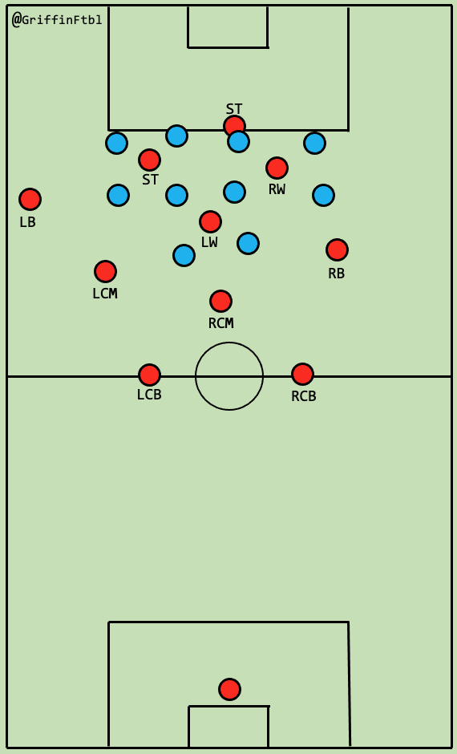

Slide 2
@GriffinFtbl
LW
LB
CB
LCM/CB
CM/CB
CB
CM
RB
ST
SS
RW

Slide 3
@GriffinFtbl

Slide 4
@GriffinFtbl
LCM
RB

Slide 5
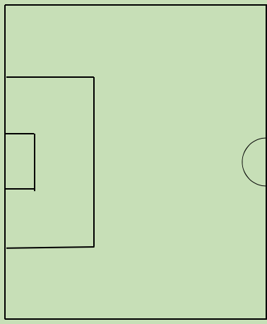

Slide 6
@GriffinFtbl
LB
LCM
RCM
RB

Slide 7
@GriffinFtbl

Slide 8
@GriffinFtbl
Vlahovic
Cordoba
Grealish
Son
Bergwijn
Ndombele
Lo Celso
Hojbjerg
Skipp
Tchouameni
Regulion
Sessegnon
Tanganga
Foyth
Rodon
Toby
Lacroix
Sanchez
Maignan

Slide 13
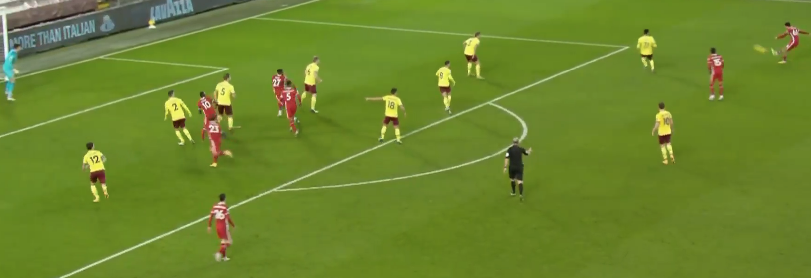
@GriffinFtbl
Alexander-Arnold’s Crossing vs Burnley - 8
· Numbers in the box but the defence is sat fairly deep but the runs aren’t that dangerous
· Decent quality cross to the back post but the RB gets there before Shaqiri
· Not enough space behind to exploit and Pope is an aerial presence too

Slide 14
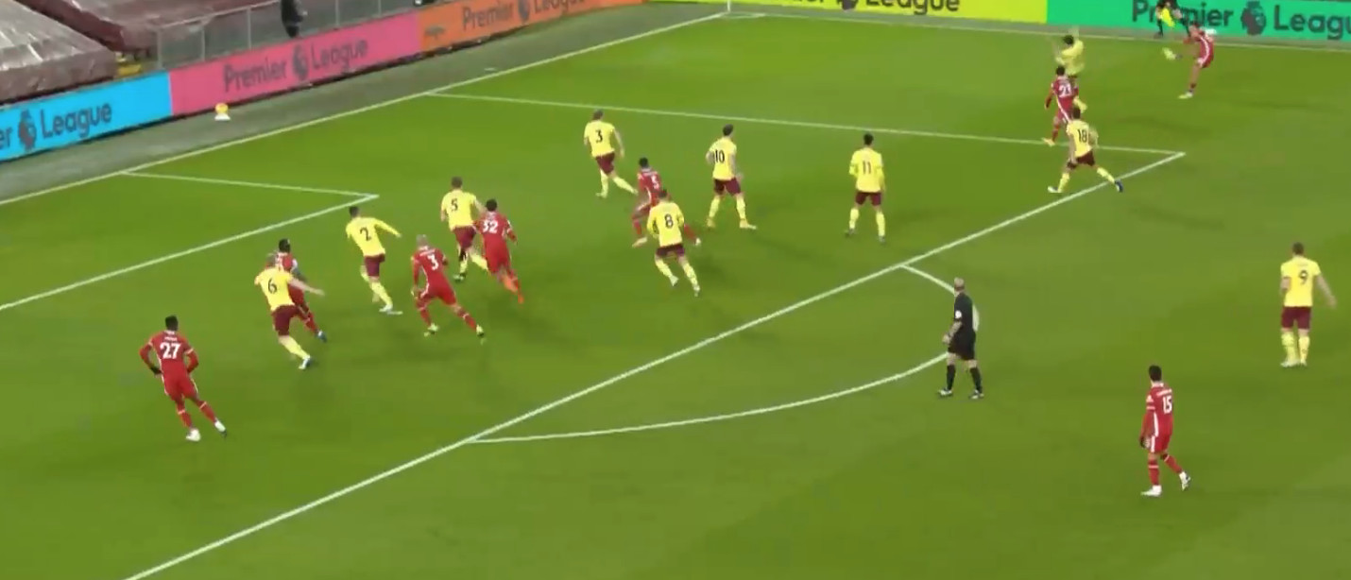
@GriffinFtbl
Alexander-Arnold’s Crossing vs Burnley - 2
· His corner is cleared but goes back out to him, not much to say here as it gets blocked easily by a Burnley defender
· If that defender isn’t there then they have a good setup in the box with plenty of runners that were there for the corner and the back post is vulnerable
· Alternatively he could have used Shaqiri’s 23 run (dotted)

Slide 19
4v1 Rectangular Rondo
• 5 minutes
• GK at base
• 1 or 2 touch if possible
• Focus on technique and making angles

